Slide 1

Vehicle Rental System
-Astha Gupta

Slide 2
Objective
Develop a Vehicle Rental System that enables users to rent vehicles for travel while providing admins with tools to manage fleet availability, rental pricing, and order approvals. The system will incorporate role-based authentication, real-time vehicle availability tracking, order processing, and performance optimization using Redis caching and AOP logging.

Slide 3
Key Features
User Authentication:
Role-based access control (Admin, Customer) using Spring Security.
Secure login and registration for users.
Vehicle Management:
CRUD operations for vehicle inventory (add, update, delete, view).
Real-time tracking of vehicle availability based on rental dates.
Order Processing:
Customers can book rentals with order tracking.
Support for pagination to handle large datasets.

Slide 4
4. Redis Caching:
Store frequently accessed data (e.g., available vehicles) for fast retrieval.
Improve system performance and reduce database load.
5. AOP Logging:
Track rental transactions and API usage for monitoring and debugging.
Log critical operations like bookings, cancellations, and admin actions.
6. Admin Privileges:
Manage vehicle inventory and update rental prices.
Approve or reject rental requests from customers.
7. Customer Features:
Browse available vehicles with detailed rental information.
Book rentals and view rental history.
Cancel bookings before a specified deadline.

Slide 5
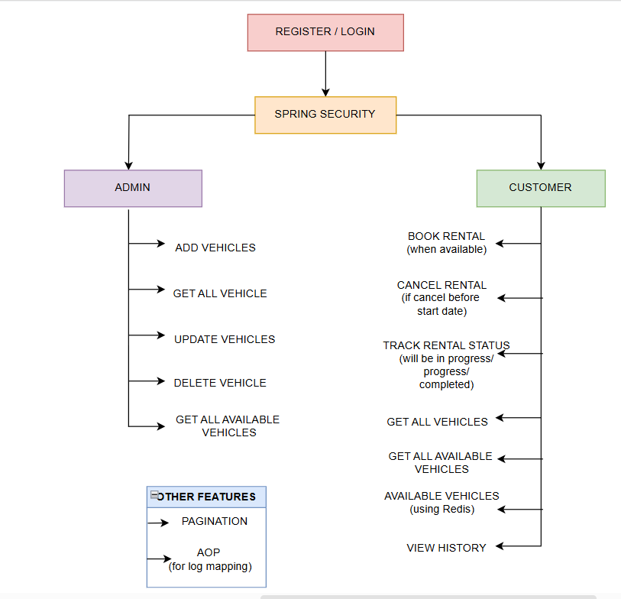

Slide 6
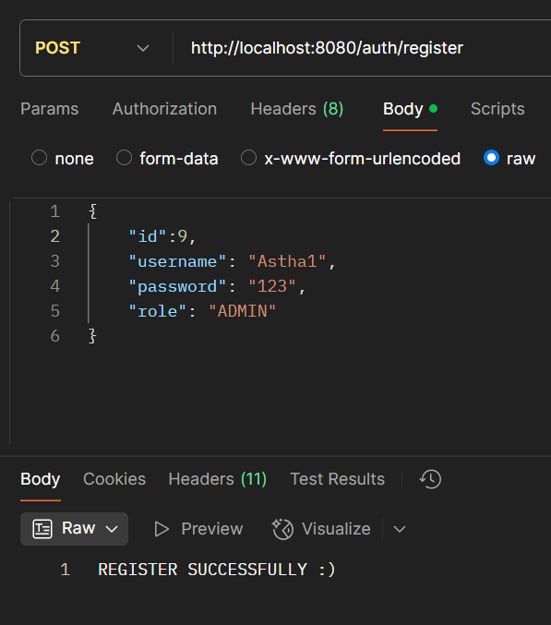
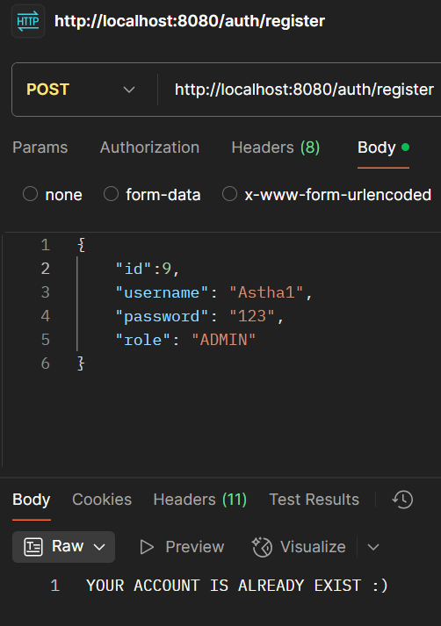
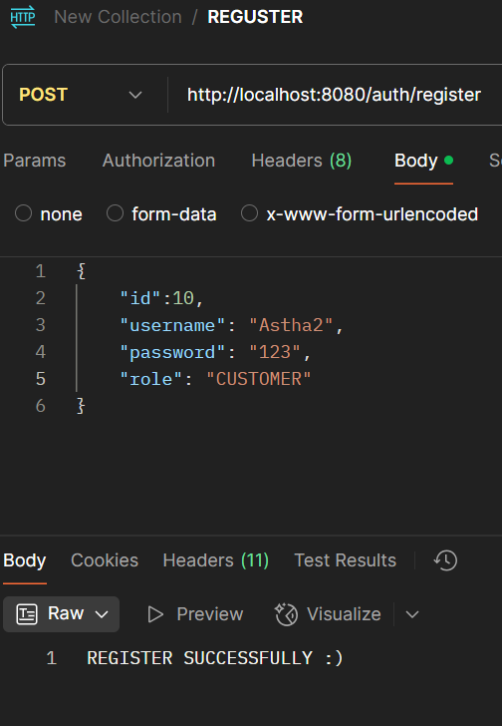
Features

Slide 7
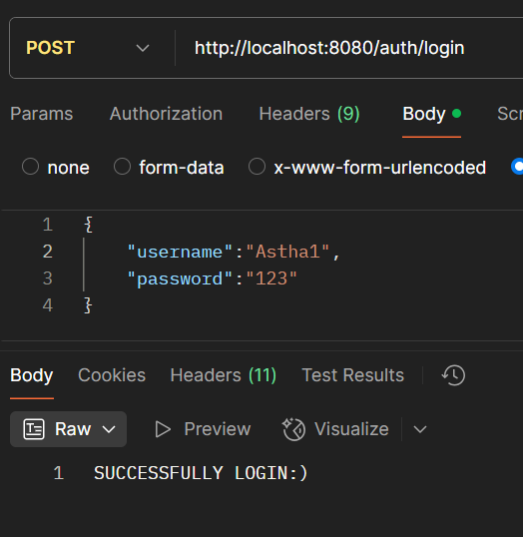
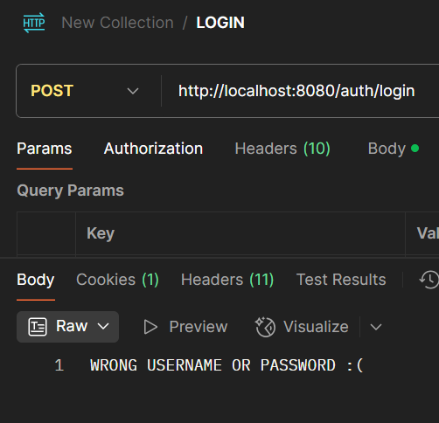
Login

Slide 8
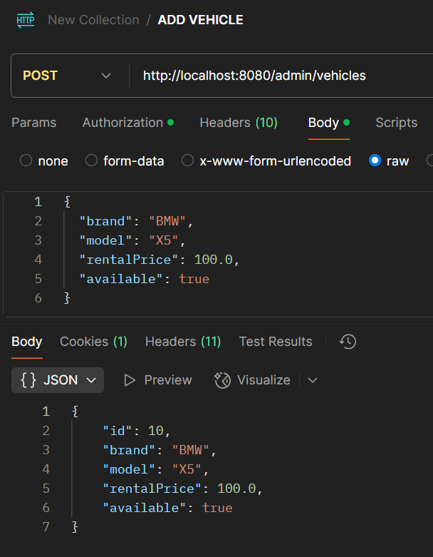
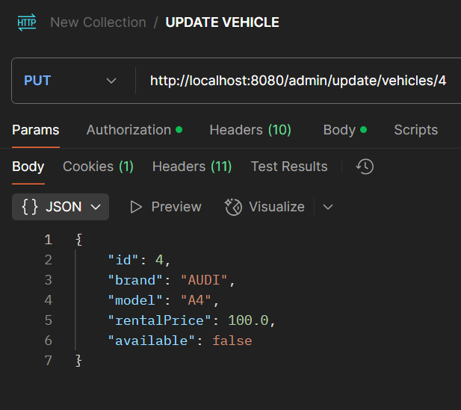
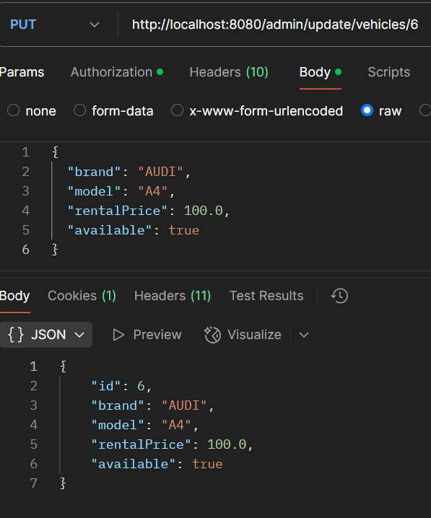
Vehicle Management- Admin

Slide 9
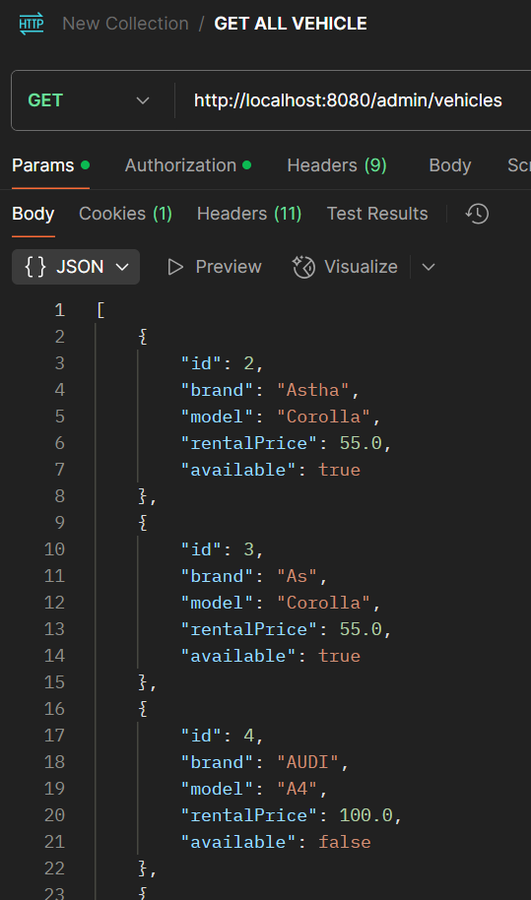
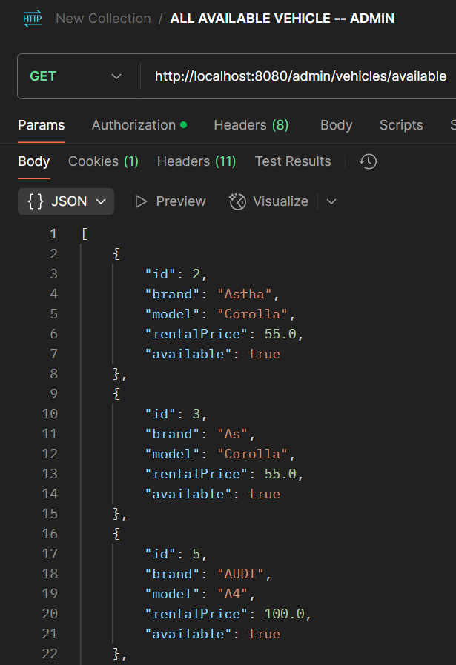

Slide 10
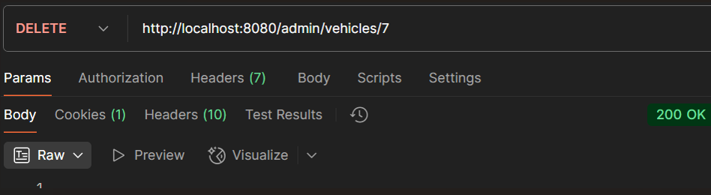

Slide 11
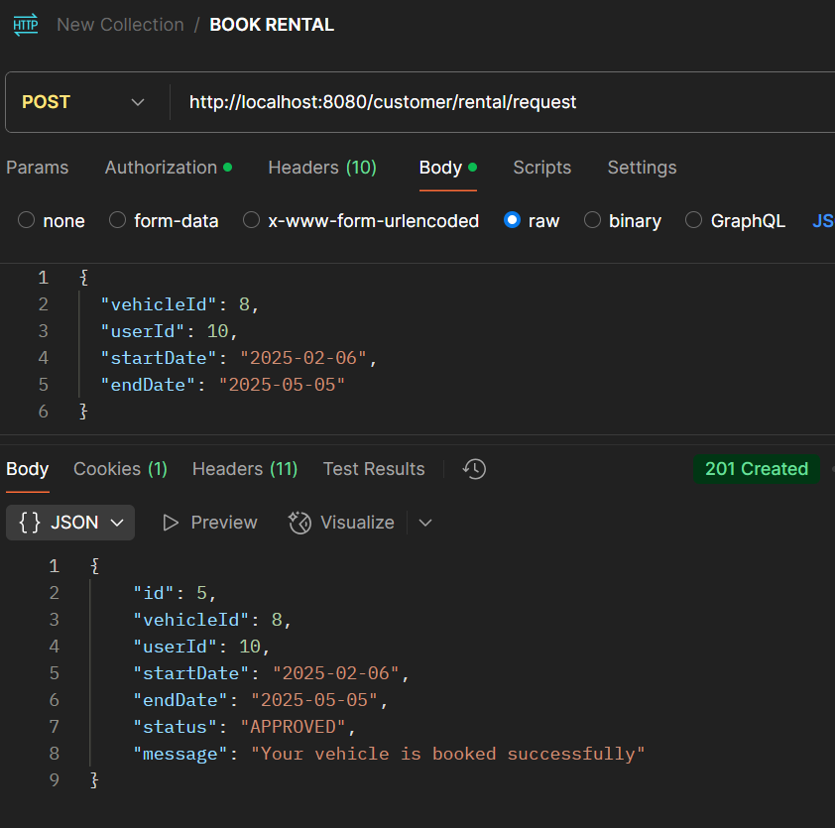
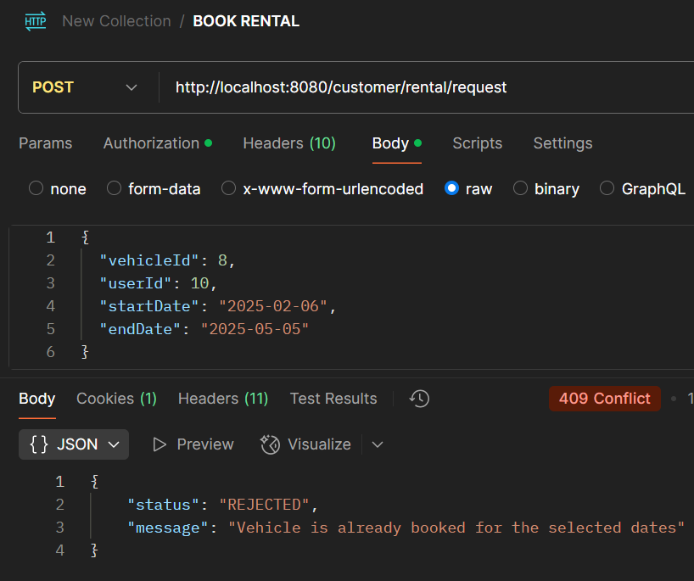
Customer Features

Slide 12
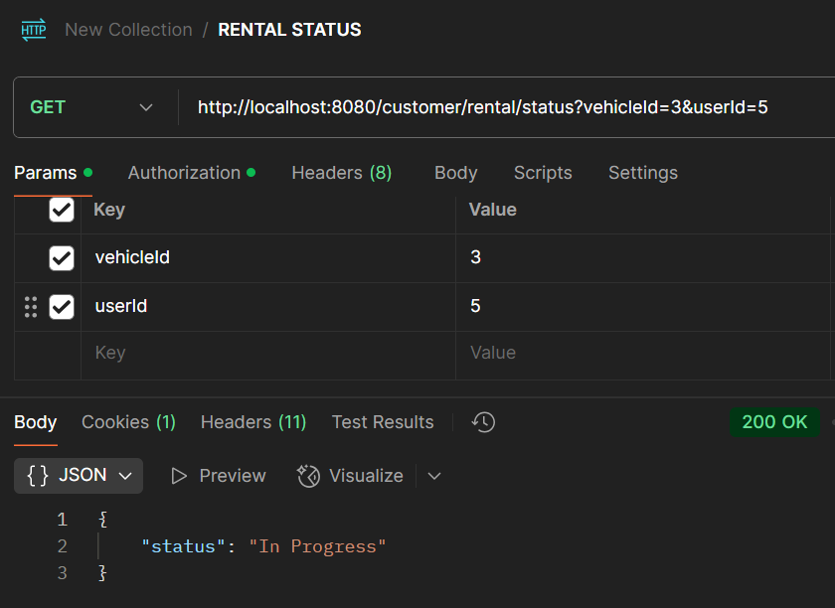
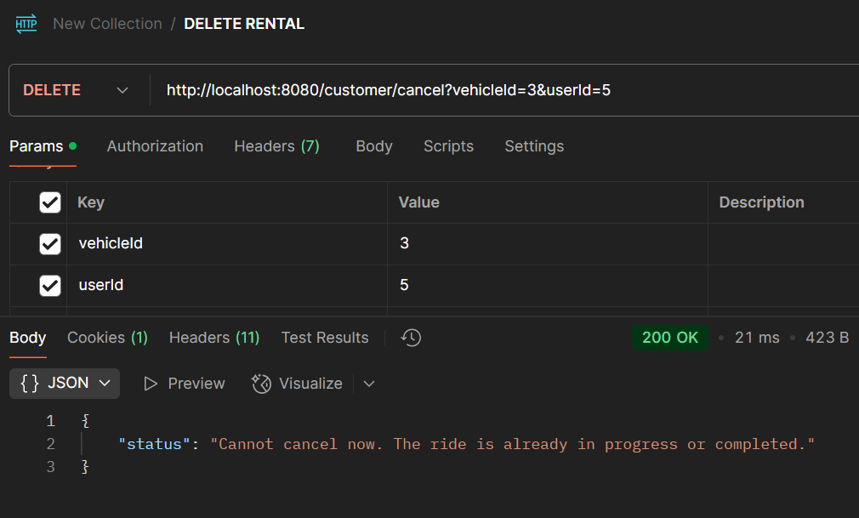

Slide 13
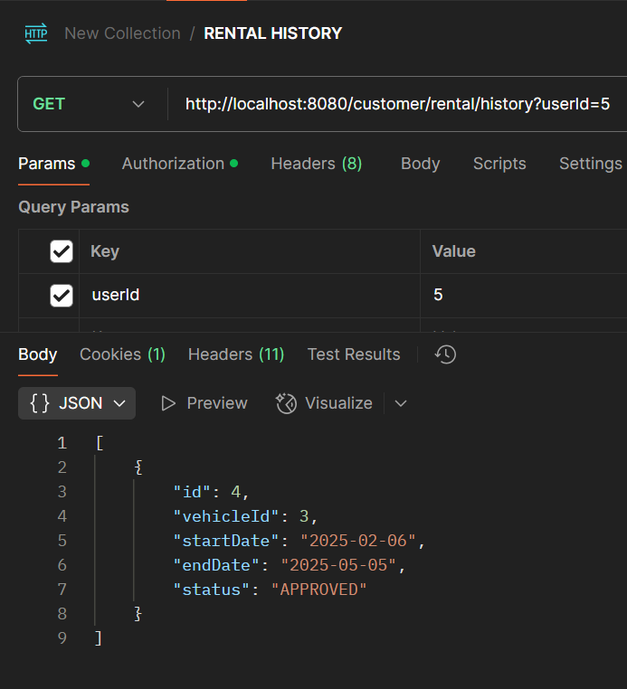
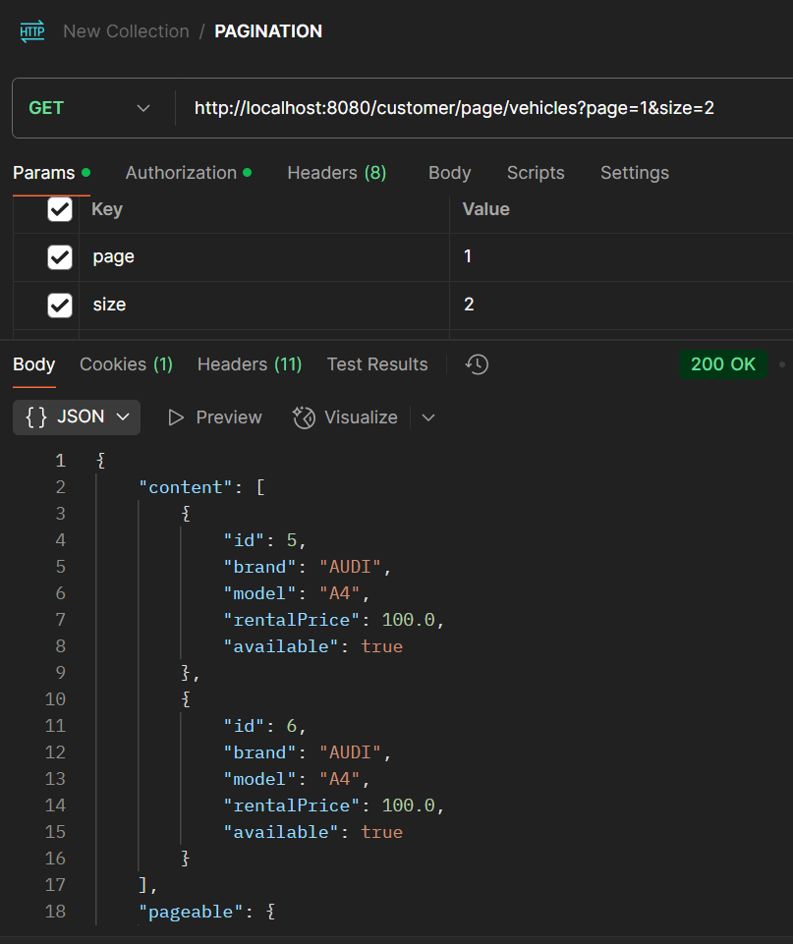

Slide 14
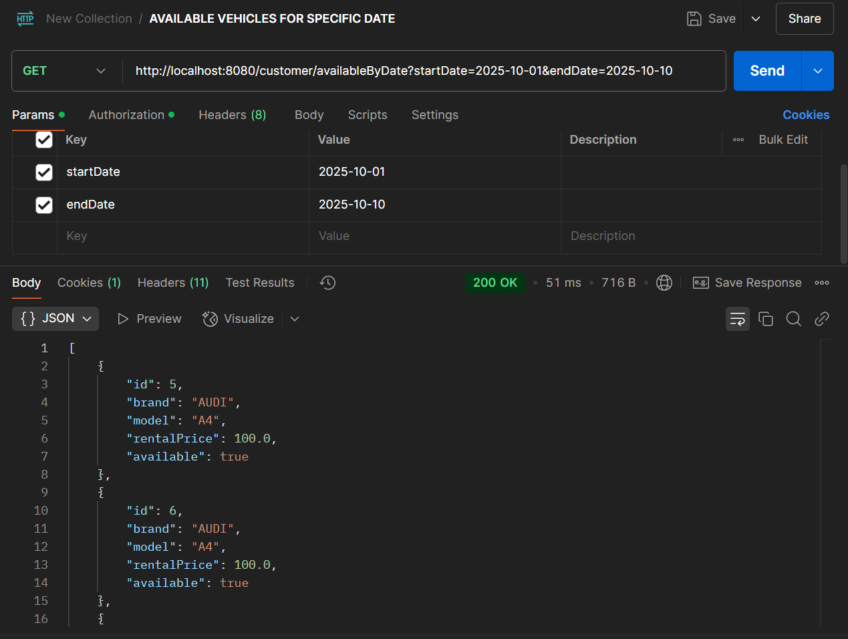

Slide 15
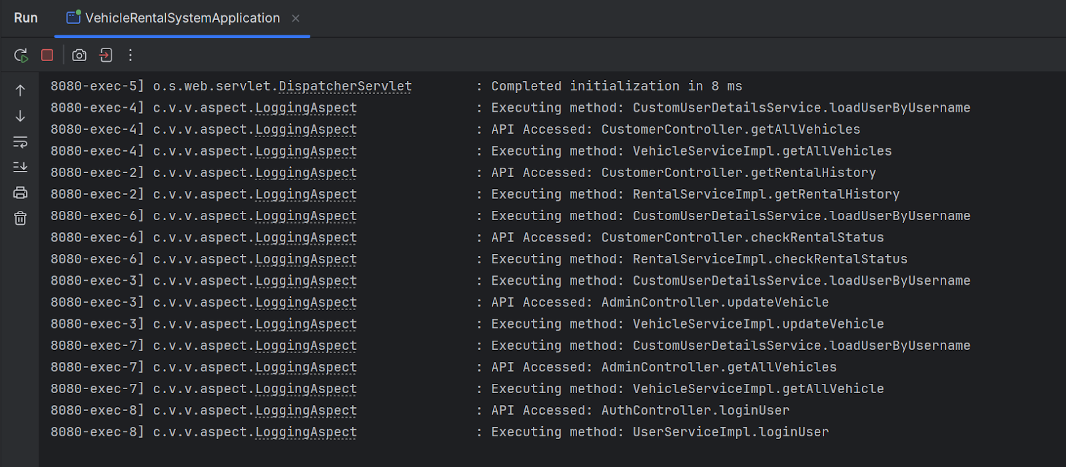
AOP log details

Slide 16


